Slide 1
Introduction to DHTC
Brian Lin
OSG Software Team
University of Wisconsin - Madison

Slide 2
Local High Throughput Computing
resources
local
UW - Madison
compute

Slide 3
Local High Throughput Computing
resources
local
UW - Madison
compute

Slide 4
How do you get more computing resources?

Slide 5
#1: Buy Hardware

Slide 6
#1: Buy Hardware
Great for specific hardware/privacy requirements
Costs $$$
Initial cost
Maintenance
Management
Power and cooling
Delivery and installation takes time
Rack/floor space
Obsolescence
Plan for peak usage, pay for all usage

Slide 7
#2: Use the Cloud

Slide 8
#2: Use the Cloud - Pay per cycle
e.g. Amazon Web Services, Google Compute Engine, Microsoft Azure, Rackspace
Fast spin-up
Costs $$$
Still needs expertise + management
Easier than in the past with the condor_annex tool
Does payment fit with your institutional or grant policies?

Slide 9
#2: Use the Cloud - ‘Managed’ clouds
e.g. Cycle Computing, Globus Genomics
Pay someone to manage your cloud resources — still costs $$$
Researchers and industry have used this to great success
Using Docker, HTCondor, and AWS for EDA Model Development
Optimizations in running large-scale Genomics workloads in Globus Genomics using HTCondor
HTCondor in the enterprise
HTCondor at Cycle Computing: Better Answers. Faster.

Slide 10
#3: Share Resources

Slide 11
#3: Share Resources - Distributed HTC
University of Chicago
University of Nebraska - Lincoln
UW - Madison

Slide 12
i.
Split Up Your Jobs Manually
Let’s start sharing!

Slide 13

Manual Job Split
Obtain login access
Query each cluster for idle resources
Split and submit jobs based on resource availability
Photo by Denys Nevozhai on Unsplash

Slide 14
#3: Share Resources - Distributed HTC
University of Chicago
University of Nebraska - Lincoln
UW - Madison

Slide 15
#3: Share Resources - Distributed HTC
University of Chicago
University of Nebraska - Lincoln
UW - Madison

Slide 16
Manual Job Split - Shortcomings
Fewer logins = fewer potential resources
More logins = more account management
Why would they give you accounts? Are your friends going to want CHTC accounts?
Querying and splitting jobs is tedious and inaccurate
Not all clusters use HTCondor — other job schedulers e.g., SLURM, PBS, etc.
Pools are independent — workflows must be confined to a single pool

Slide 17
ii.
Split Up Your Jobs Automatically
Let the computers do the work

Slide 18

Automatic Job Split - Shortcomings
Homer: Kids: there's three ways to do things; the right way, the wrong way and the Max Power way!
Bart: Isn't that the wrong way?
Homer: Yeah, but faster!
Groening, M (Writer), Michels, P. (Director) . (1999). Homer to the Max [Television Series Episode]. In Scully, M. (Executive Producer), The Simpsons. Los Angeles, CA: Gracie Films

Slide 19
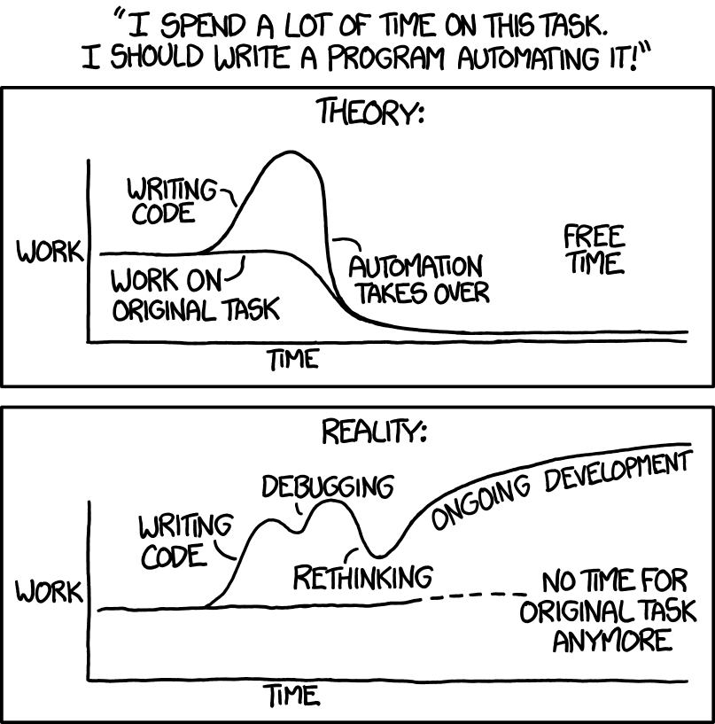
Automatic Partitions - Shortcomings
Source: https://xkcd.com/1319/

Slide 20
#3: Share Resources - Requirements
Minimal account management
No job splitting
DAG workflow functionality
HTCondor only!
No resource sharing requirements

Slide 21
iii.
Overlay Systems
Let the OSG do the heavy lifting

Slide 22
The OSG Model
OSG Submit and CM
OSG
Cluster

Slide 23


The OSG Model
OSG Submit and CM
OSG
Cluster

Slide 24
The OSG Model
Pilot Jobs
OSG Submit and CM
OSG
Cluster

Slide 25
The OSG Model
Pilot Jobs
OSG Submit and CM
OSG
Cluster

Slide 26




Job Matching
On a regular basis, the central manager reviews Job and Machine attributes and matches jobs to slots.
execute
submit
central manager
execute
execute

Slide 27
The OSG Model
OSG Submit and CM
OSG
Cluster

Slide 28

The OSG Model - Jobs in Jobs
Photo Credit: Shereen M, Untitled, Flickr https://www.flickr.com/photos/shereen84/2511071028/ (CC BY-NC-ND 2.0)

Slide 29
#3: Share Resources - Requirements
Minimal account management: only one submit server
No job splitting: only one HTCondor pool
DAG workflow functionality: Only one HTCondor pool
HTCondor only: Only one HTCondor pool
No resource sharing requirements: the OSG doesn’t require that users “pay into” the OSG

Slide 30
The OSG Model - Recap
Pilot jobs (or pilots) are special jobs
Pilots are sent to sites with idle resources
Pilot payload = HTCondor execute node software
Pilot execute node reports to your OSG pool
Pilots lease resources:
Lease expires after a set amount of time or lack of demand
Leases can be revoked!

Slide 31
The OSG Model - Leasing the Cloud
What if there aren’t enough idle resources?
Combine overlay system with cloud technology
Some of your OSG jobs may run in the cloud in the next few years
… but this should be completely transparent to you

Slide 32

The OSG Model - Collection of Pools
Your OSG pool is just one of many
Separate pools for each Virtual Organization (VO)
Your jobs will run on the OSG VO pool
Photo by Martin Sanchez on Unsplash

Slide 33
The OSG Model - Getting Access
During the school:
OSG submit node at UW (exercises)
OSG submit node via OSG Connect (exercises)
After the school:
Both of the above
Institution-hosted submit node
VO-hosted submit nodes

Slide 34
Questions?

Slide 35

Overlay Systems are Awesome!
Photo by Zachary Nelson on Unsplash

Slide 36
What’s the Catch?
Requires more infrastructure, software, set-up, management, troubleshooting...

Slide 37
“You know you have a distributed system when the crash of a computer you’ve never heard of stops you from getting any work done.”
- Leslie Lamport

Slide 38
#1: Heterogenous Resources
Accounting for differences between the OSG and your local cluster

Slide 39
Sites of the OSG
Source: http://display.opensciencegrid.org/

Slide 40
Heterogeneous Resources - Software
Different operating systems (Red Hat, CentOS, Scientific Linux; versions 6 and 7)
Varying software versions (e.g., at least Python 2.6)
Varying software availability (e.g., no BLAST*)
Solution: Make your jobs more portable: OASIS, containers, etc (more in Wednesday’s talks)

Slide 41
Hetero. Resources - Hardware
CPU: Mostly single core
RAM: Mostly < 8GB
GPU: Limited #s but more being added
Disk: No shared file system (more in Thursday’s talks)
Solution: Split up your workflow to make your jobs more high throughput

Slide 42
#2: With Great Power Comes Great Responsibility
How to be a good netizen

Slide 43

Resources You Don’t Own
Primary resource owners can kick you off for any reason
No local system administrator relationships
No sensitive data (again)!
Photo by Nathan Dumlao on Unsplash

Slide 44
Be a Good Netizen!
Use of shared resources is a privilege
Only use the resources that you request
Be nice to your submit nodes
Solution: Test jobs on local resources with condor_submit -i

Slide 45
#3: Slower Ramp Up
Leasing resources takes time!

Slide 46
Slower Ramp Up
Adding slots: pilot process in the OSG vs slots already in your local pool
Not a lot of time (~minutes) compared to most job runtimes (~hours)
Small trade-off for increased availability
Tip: If your jobs only run for < 10min each, consider combining them so each job runs for at least 30min

Slide 47
Robustify Your Jobs
Succeeding in the face of failure

Slide 48
Job Robustification
Test small, test often
Specify output, error, and log files at least while you develop your workflow
Use on_exit_hold to catch different failure modes
on_exit_hold = (ExitCode =?= 3)
on_exit_hold = (time() - JobCurrentStartDate < 1 * $(HOUR))
For jobs that run too long:
periodic_hold = (time() - JobCurrentStartDate > 4 * $(HOUR))
periodic_release = (HoldReasonCode == 3) && (NumJobStarts < 3)
HoldReasonCode is 3 for any jobs where on_exit_hold or periodic_hold evaluate to True

Slide 49
Job Robustification
In your own code:
Self checkpointing
Different exit codes for use with on_exit_hold
Defensive troubleshooting (hostname, ls -l, pwd, condor_version in your wrapper script)
Add simple logging (e.g. print, echo, etc)

Slide 50
Questions?

